Slide 1

CMR COLLEGE OF ENGINEERING & TECHNOLOGY
Kandlakoya, Medchal, Hyderabad - 501401
Department of Computer Science and Engineering
Sentiment Analysis on Social Media Posts
Batch No.:B41
Name of the students:
D.Sathvika(21H51A05D7)
G.Dheeraj(21H51A05Q4)
T.Vengal (21H51A0550)
Under esteemed guidance of
Guide Name
Dr.G.Ravi Kumar(Associate Professor)
Batch: 2021-2025 Major Project Phase 1

Slide 2
Abstract
Notes:
2

Slide 3
Outline
Abstract
Introduction
Research Objective
Problem Definition
Implementation of system
Conclusion
References
Notes:
3

Slide 4
ABSTRACT
To analyze and classify user sentiments expressed in Instagram posts, captions, and comments.
The collected posts are cleaned and prepared by removing unnecessary characters, breaking down the text into words, and standardizing the text.
Understand general public perception on topics, trends, and brands by identifying sentiment (positive, negative, neutral).
Explore the correlation between post features (hashtags, user profiles, timestamps) and sentiment trends.

Slide 5
INTRODUCTION
Notes:
5

Slide 6
Introduction
Instagram has become one of the most popular social media platforms globally, with billions of active users engaging daily through posts, stories, and Reels.
Users share opinions, experiences, and emotions, making it a valuable platform for brands, public figures, and businesses to gauge public sentiment and engagement.
Sentiment analysis on instagram can inform product launches, brand perception management, and audience-driven campaigns.

Slide 7
Research Objective
Notes:
7

Slide 8
Research objective
Identify and analyze sentiment: Develop a model to classify Instagram post sentiments (positive, negative, neutral) based on captions, comments, or hashtags.
Gain insights on audience reactions: Understand user engagement and public opinion related to specific topics, trends, or brands.
Assist in decision-making: Enable businesses or influencers to tailor content strategies based on sentiment trends and audience preferences.
Enhance brand image management: Detect negative feedback promptly to address concerns and improve brand reputation.

Slide 9
Problem Statement
Notes:
9

Slide 10
Problem Definition
The project aims to develop a sentiment analysis model for Instagram posts to classify user-generated content (captions, comments, hashtags) into positive, negative, or neutral sentiments. Despite Instagram's immense popularity, understanding and analyzing the vast volume of user feedback remains challenging for brands and influencers who seek to gauge audience reactions. This project will address the gap by automating sentiment detection, enabling efficient monitoring of public opinion, and providing actionable insights that can guide decision-making and manage brand reputation on social media.

Slide 11
Scope of the Project
Notes:
11

Slide 12
Scope of the Project
Data Collection: Gather Instagram posts, including captions, comments, and hash tags, to create a dataset for sentiment analysis.
Data Preprocessing: Clean and prepare the text data by removing irrelevant content (like emojis or special characters).
Sentiment Model Development: Build a machine learning or deep learning model to classify text into sentiment categories (positive, negative, neutral).
Model Training and Testing: Train and validate the model on a labeled dataset, optimizing for accuracy, precision, and recall to ensure effective sentiment prediction.
Performance Evaluation and Improvement: Measure the model’s accuracy and explore improvements based on feedback, user testing, or model retraining with new data.

Slide 13
Literature Review
Notes:
13

Slide 14
Implementation of Solution
Authentication to Instagram:
Uses Instaloader to log in using Firefox cookies.
Retrieves session cookies from the Firefox database.
Checks if login is successful, else exits.
Scraping Instagram Comments
Extracts post shortcode from the given URL.
Uses Instaloader to get comments, usernames, and like counts.
Saves data in a CSV file for further analysis.
Sentiment Analysis
Loads the scraped comment data from the CSV file.
Uses BiLSTM to calculate sentiment polarity range.
Classifies comments into Positive, Negative, or Neutral.
Adds sentiment labels as a new column in the dataset.
Visualization of Sentiment
Groups comments by sentiment for analysis.
Plots a sentiment distribution graph using Matplotlib.
Uses different colors for Positive (green), Negative (red), and Neutral (gray).
.

Slide 15
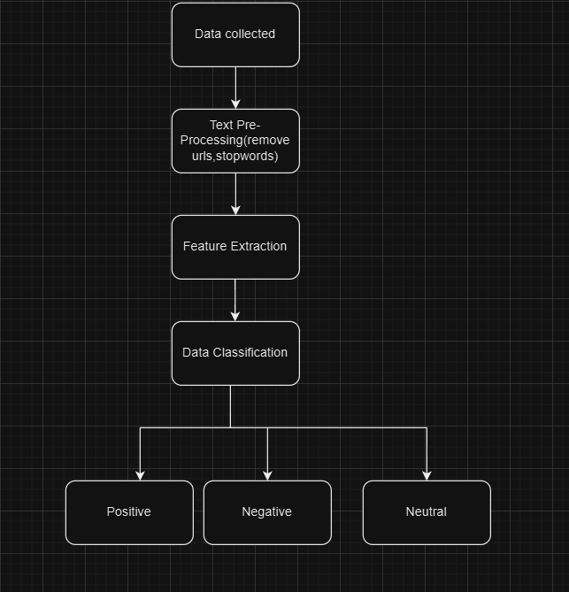
Implementation of Solution

Slide 16
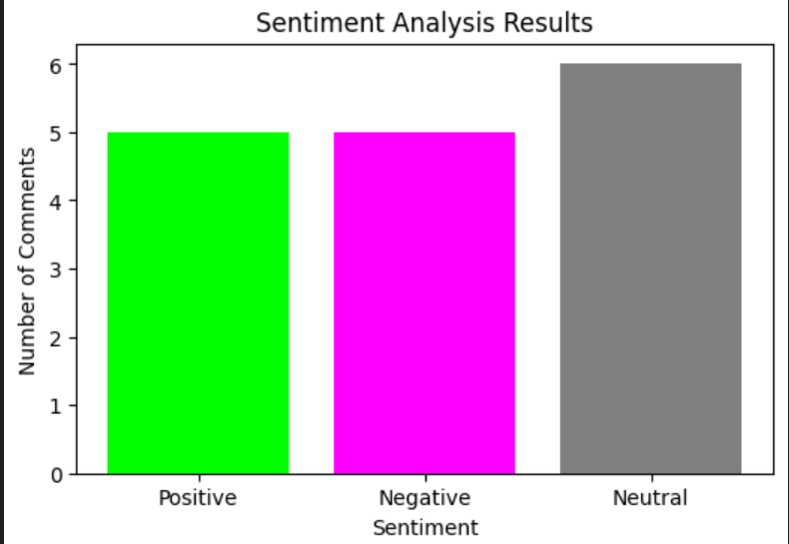
Result
Sentiment Scores: Categorization of posts as positive, negative, or neutral.
Trend Analysis: Visual representation of sentiment trends over time.
Sentiment Distribution: Charts showing overall sentiment proportions (e.g., pie or bar charts).
Performance Metrics: Model evaluation metrics like accuracy, precision, and recall.

Slide 17
Conclusion
In conclusion, the Instagram sentiment analysis project successfully demonstrates the valuable insights from social media data. By categorizing posts into positive, negative, and neutral sentiments, the project enables a deeper understanding of user attitudes and trends over time. This project shows how sentiment analysis can be a valuable tool for businesses, influencers, and researchers to make data-driven decisions based on real-time social media trends.

Slide 18
References
https://www.researchgate.net/publication/379118930_Sentiment_Analysis_of_Twitter_Data_Using_Machine_Learning_Techniques#:~:text=Twitter%20sentiment%20analysis%20examines%20the,neutral%20depending%20on%20their%20content.
https://www.researchgate.net/publication/356400882_Sentiment_Analysis_in_Social_Media_Data_for_Depression_Detection_Using_Artificial_Intelligence_A_Review
http://www.mdpi.com/2076-3417/13/7/4550
https://ieeexplore.ieee.org/document/10434704
https://www.researchgate.net/publication/334044999_Impact_of_Agricultural_Subsidies_Policy_on_Turkey_Dairy_Farming_By_Using_Binary_Logit_Model
https://onlinelibrary.wiley.com/doi/10.1002/eng2.12579

